Slide 1

Are we by default social?
Alex Xinyi Ye; Ayan Mahapatra; Deng Pan; Fatma Çelebi; Jialin Li
Mentor and TAs: Sina Mansour L.; Emeka Ogbuju; Ashish Sahoo
Pod: Babute; MegaPod: Rigel
Notes:
logo, cover, general question (title page), general background (social vs DMN) (2pages: title+first intro, 1min)

Slide 2
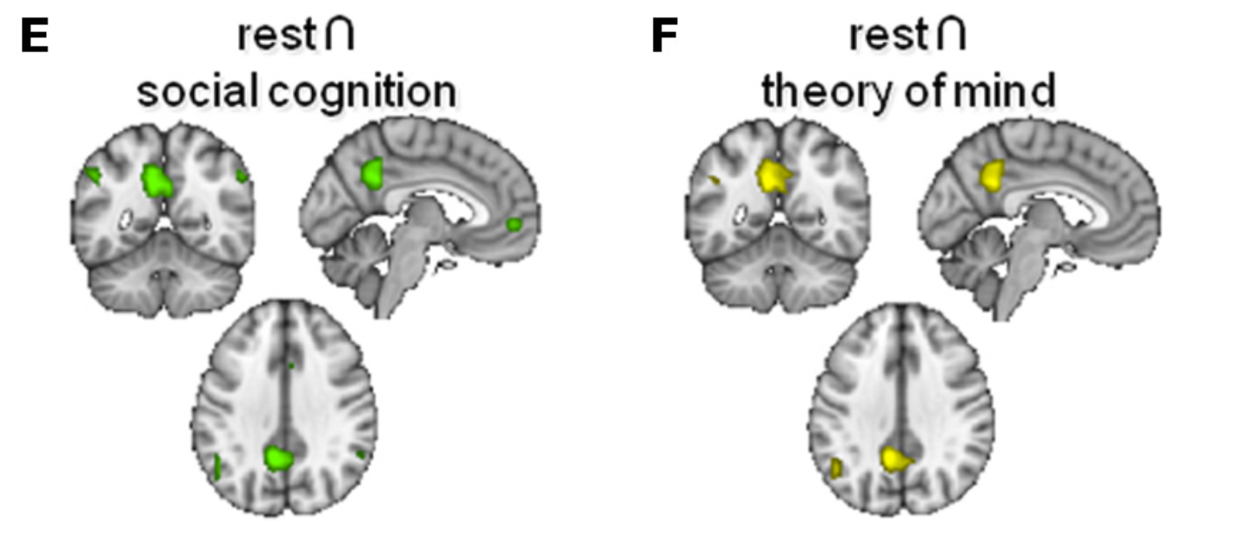
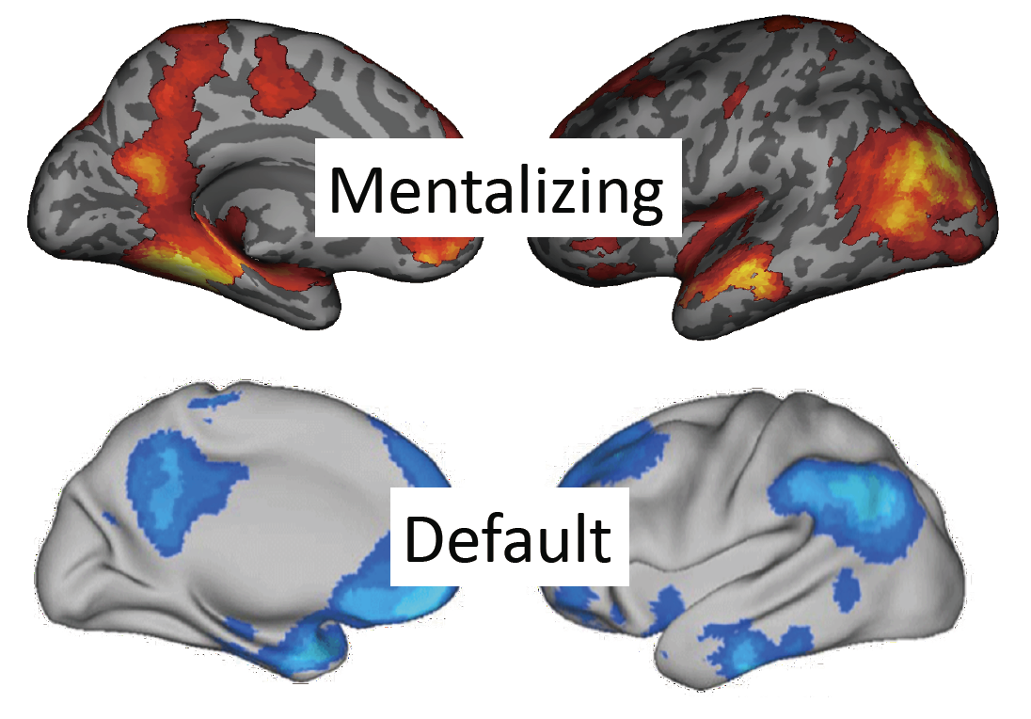
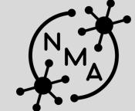
General Question
Does the connectivity of brain regions involved in social cognition task share more similarity with the resting-state than other tasks?
Spunt & Lieberman, 2012; Mars et al. 2012
Compare functional connectivity of social cognition vs. resting state
Social dragons

Slide 3
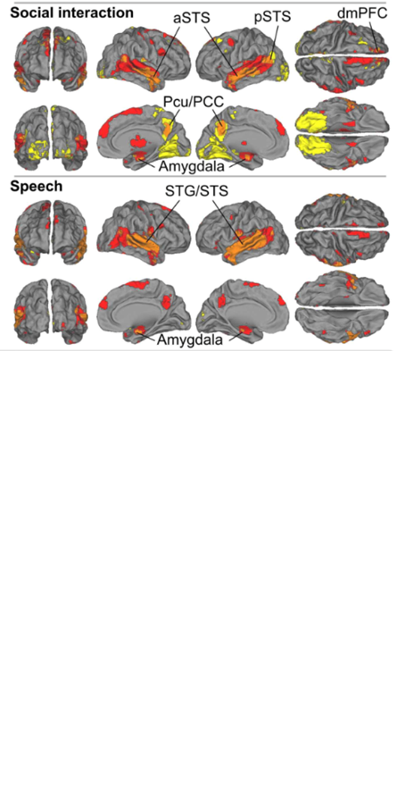
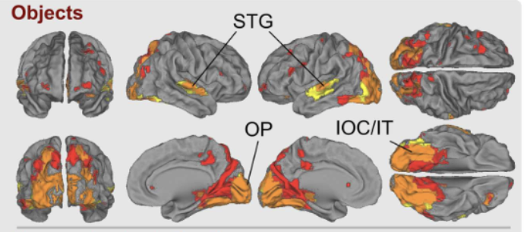
Hypothesis
The similarity between social cognition brain networks and resting state is higher than the similarity between other conditions and resting state in the Human Connectome Project (HCP) dataset.
Overlapped brain areas 🡪 ROIs: Temporoparietal junction (TPJ), superior temporal sulcus (STS), Default Mode Network (DMN), etc.
Compare functional connectivity of social cognition vs. resting state
Social dragons

Slide 4
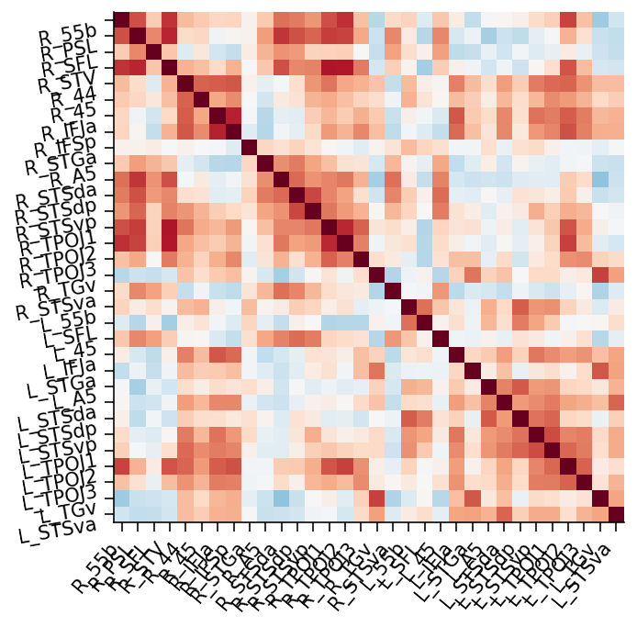
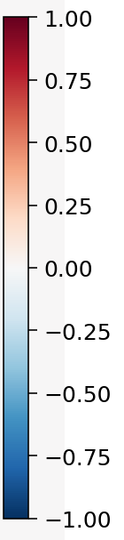
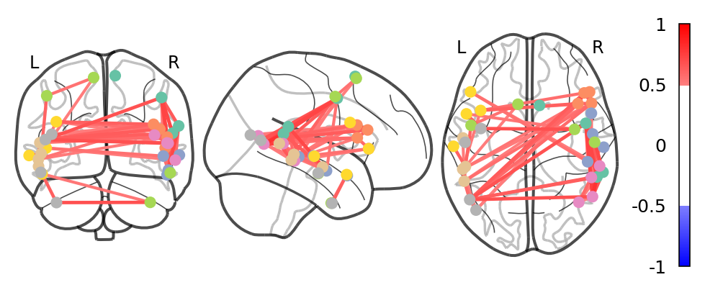
Functional Connectivity Matrices
#subject 93
Mental condition
ROIs: 32 regions
Compare functional connectivity of social cognition vs. resting state
Social dragons

Slide 5
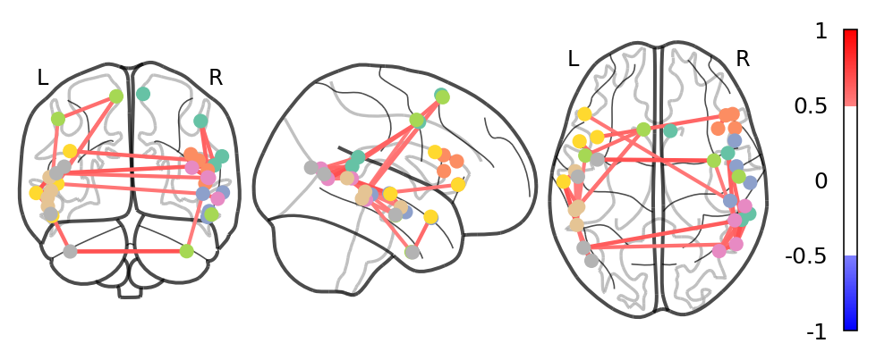
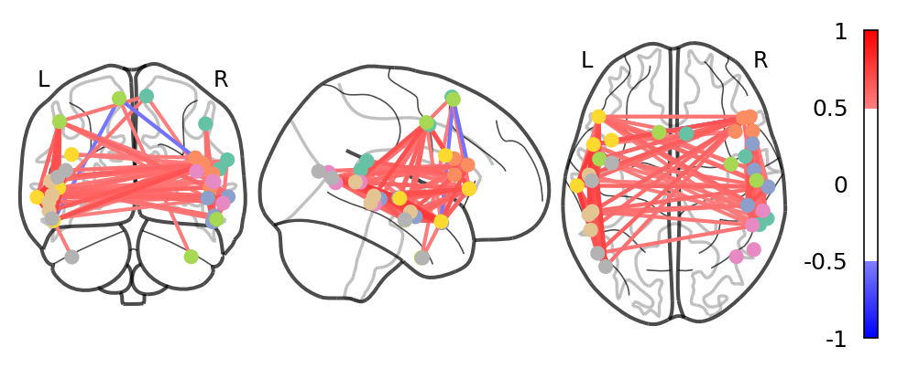
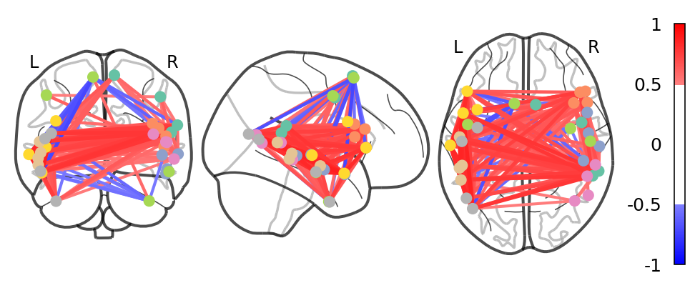
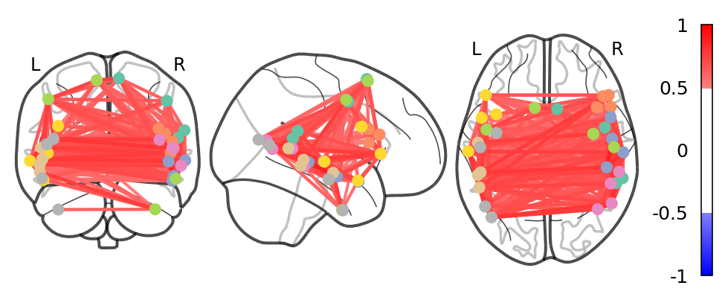
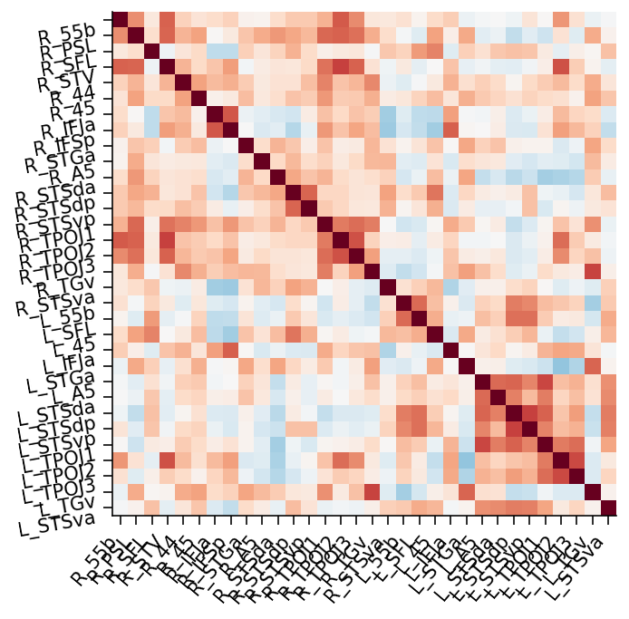
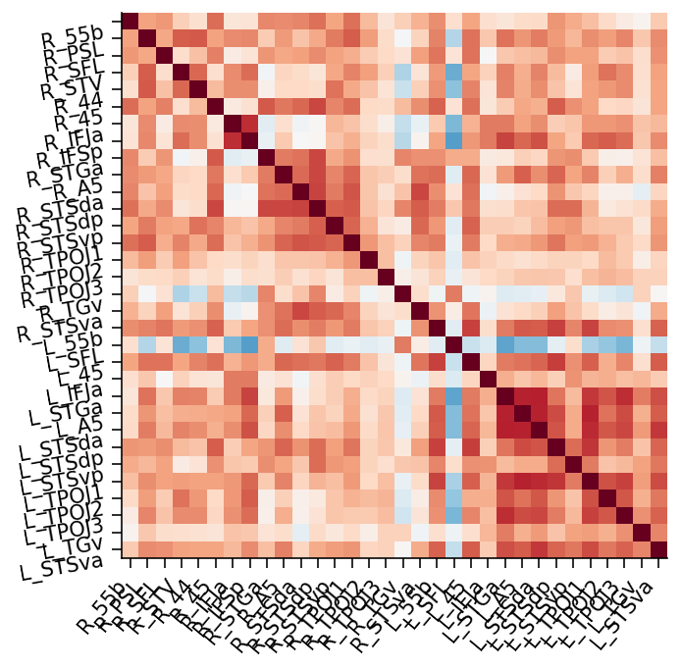
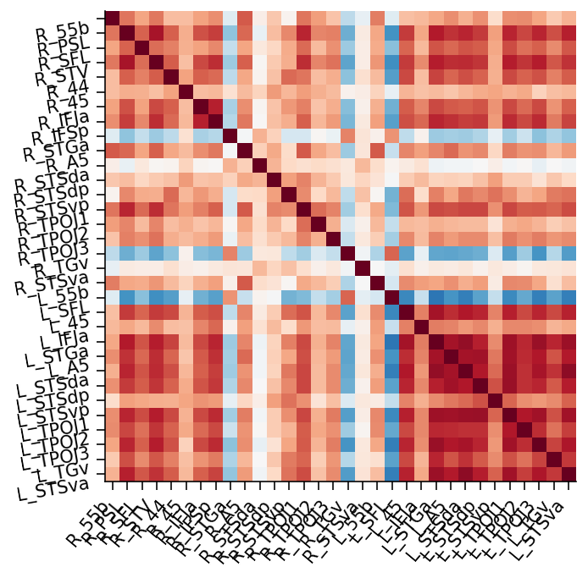
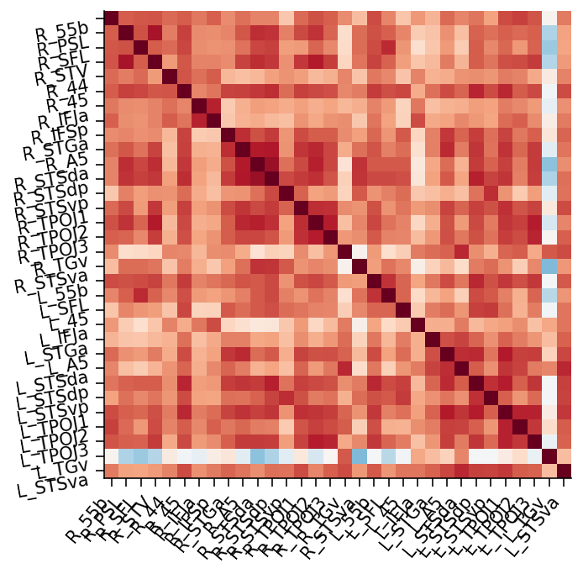
Functional Connectivity Matrices
#subject 93
Mental
Random
Story
Math
Rest
Compare functional connectivity of social cognition vs. resting state
Social dragons

Slide 6
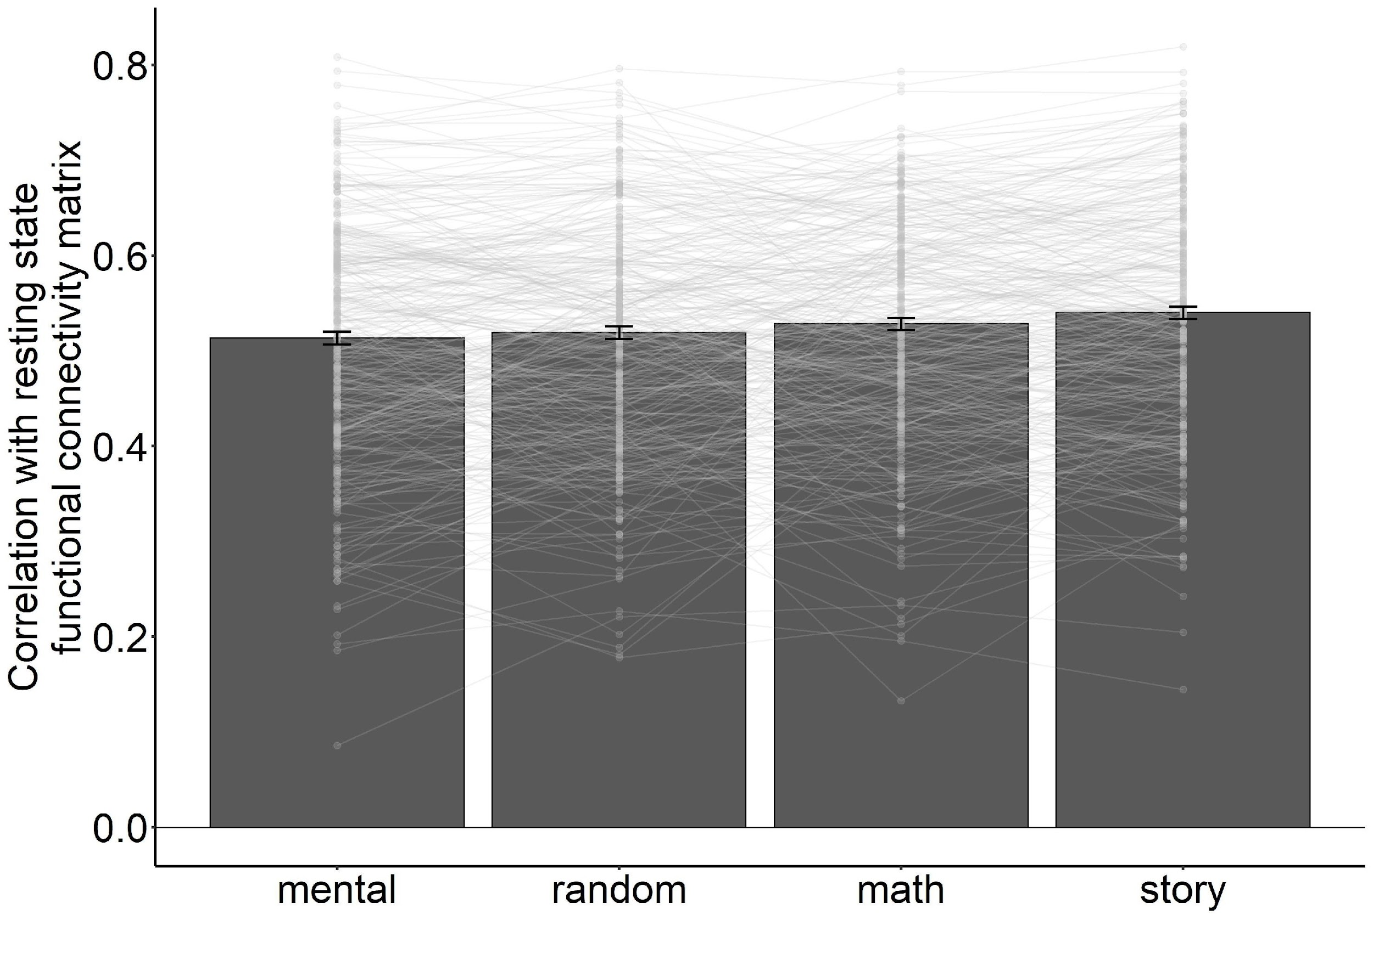
Comparison of Matrices
Whole brain (360 regions) analysis generates similar results
Pearson Correlation
Compare functional connectivity of social cognition vs. resting state
Social dragons

Slide 7
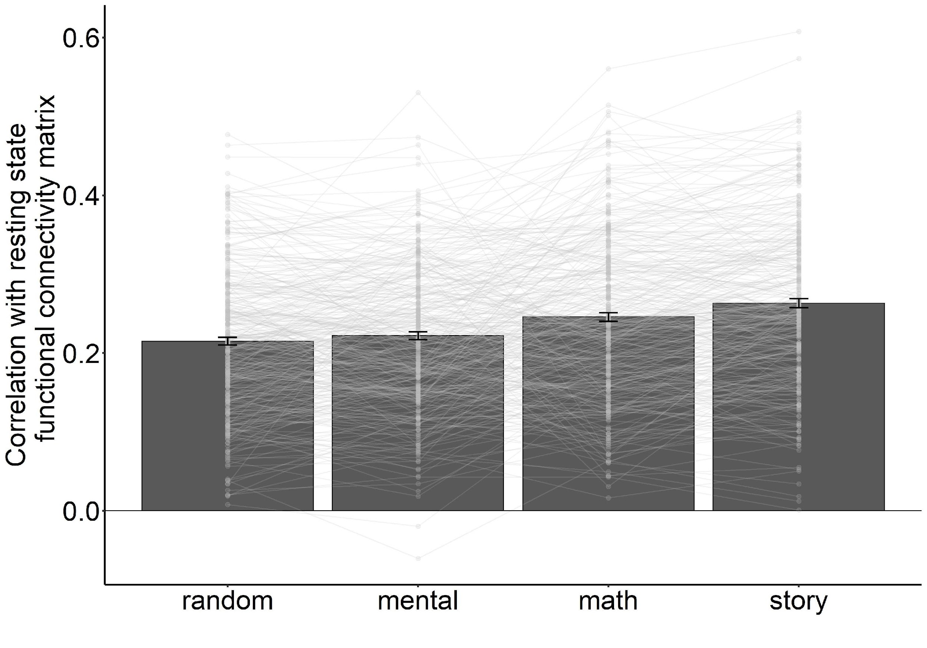
Comparison of Matrices
This analysis is done on
Whole brain (360 regions)
Correlation of
Covariance connectivity
Compare functional connectivity of social cognition vs. resting state
Social dragons

Slide 8
Conclusion
Overall, brain connectivity within the story condition from the language experiment shares the highest similarity with the brain connectivity from the resting state.
Potential reason:
Stories used in the language experiment might include more social information (Binder et al. 2011).
Compare functional connectivity of social cognition vs. resting state
Social dragons
Social dragons
Notes:
linking back to our main hypothesis, we found that the story condition from the language experiment shares the highest similarity with the brain connectivity from the resting
state. The potential reason could be the stories used in that language experiment have much social information. Because the materials are from the Aesop’s Fables

Slide 9
Discussion
Future directions
Can the brain activity in the resting predict the activity of language task or social task?
Can the story condition from language task contain more social information?
Limitation
Time series was not included in our analysis
Compare functional connectivity of social cognition vs. resting state
Social dragons
Social dragons
Notes:
Finally, we want to talk about the future directions, two future questions:…
The limitation of our project is that …

Slide 10
Q&A Time
Code: https://github.com/SocialDragonsNeuromatch/NeuromatchProject
Acknowledgment:
Sina Mansour L. our Project Mentor
Emeka Ogbuju our Project TA
Ashish Sahoo our Coursework TA
Thanks for giving us a lot of suggestions, pointers, general direction and encouragement
Compare functional connectivity of social cognition vs. resting state
Q&A
Social dragons
Social dragons
Notes:
Thank you for listening! I think now it is the Q&A time.

